Slide 1
Splat_I,I
Date: April.14/26

Slide 2

Elevator Pitch
Splat_II is a fast-paced racing game where players use grappling hooks to swing through a procedurally generated city, competing to reach the finish line in the shortest time possible.

Slide 3
Motivation
Focus on momentum-based gameplay
Encourage skill mastery through practice
Add risk/Reward decisions to movement
Notes:
Tom Splat. There was three goals that we wanted to have through development that we all came up with together. For me, my main thing was I wanted to have a high learning curve where there would be a high skill ceiling and good barrier of entry for players. For Bassam, he wanted to have a really strong movement system and that's what the Grapplin hooks are. For Ahmed, he wanted to basically have the game punish players for making errors in their movement. That's the risk. And then, so movement mastery, learning curve, risk that is immediately solving the player if they make a mistake and stopping all the movement. Gain skills through practice. That's basically using the Grapplin system and movement system there to level up your skills through practice and repetition of playing the game.

Slide 4
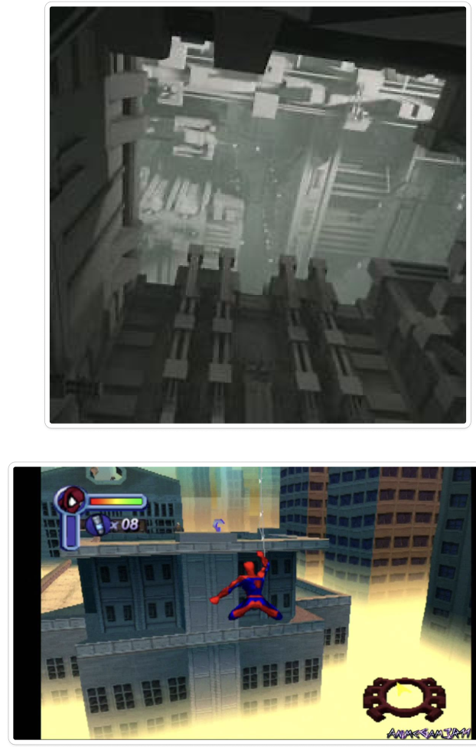
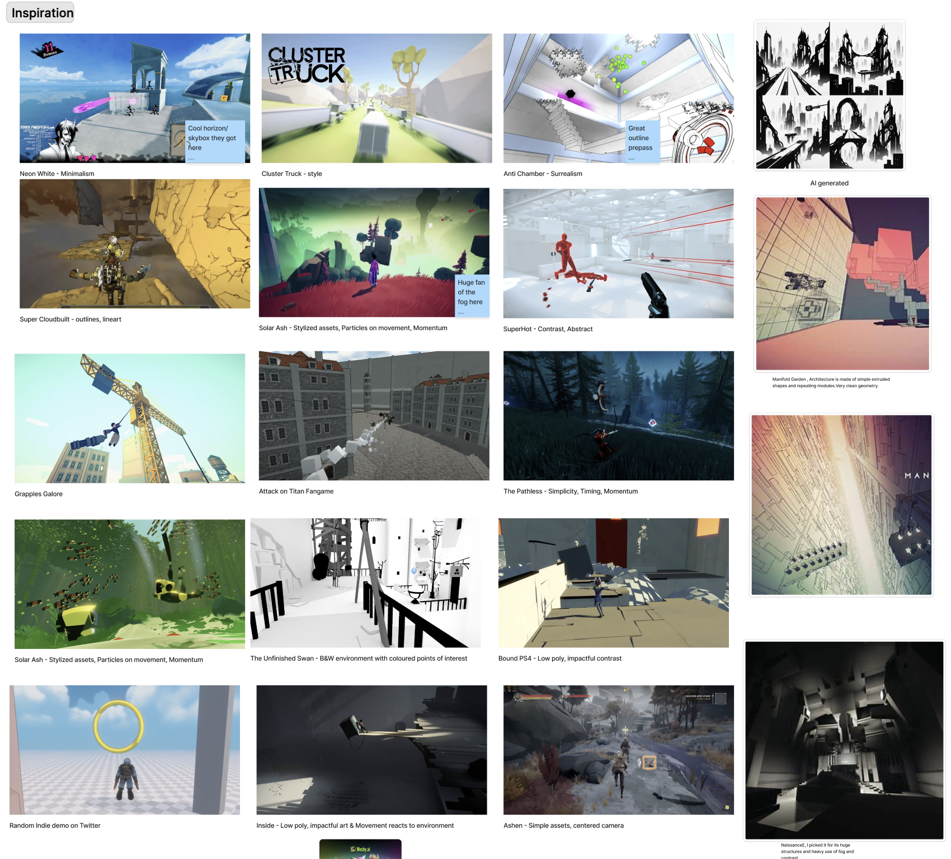

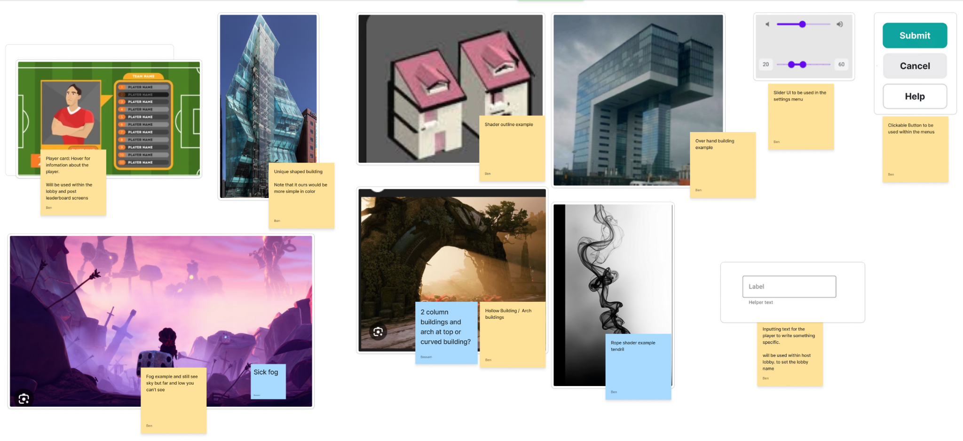
Design Decisions

Slide 5

GamePlay Visuals

Slide 6
Overview of systems
Editor
Game
Developer-facing experience
player-facing experience
Engine
Foundation both systems are built on
Notes:
Through systems that we have in our code base, we have the game which holds all the game logic and all the things the players will actually see. It has its own separate executable for players. Then we have the editor that's for our development where in the editor we can actually see and play the game but we also can edit all the values of the game and save them. And then we have the engine which is the baseline for our systems and what the game and editor are based off of.

Slide 7

VCPKG
Dependencies
Easily incorporates depdicings during Development
Setup Vcpkg
Ensured that developers had VCPKG working on their machine
Notes:
Adds a bunch of externals into our code base and it doesn't actually have to be in the GitHub repo. I was the one who first installed it onto our machines and made it work and I helped the SAM and OTHNET put it on their own machines. The main thing we wanted to use in the VC package is for the ease of use for adding external systems. For example, iGUI, which we used in the editor, which was a big system, was added. Some of the networking was easily added. Tracy, which was easily added, we had right after you put in like three lines of code, you basically had access to the experience.

Slide 8
GameObjects & Components
Game Objects
Stores Basic information
List of components
Components
Components
Defines Behaviour
Stores data
Define Behaviour
Stores data

Slide 9
Rendering System
Previously all GameObjects had a render method
Switched to using Render Components
RenderComponent submits Render Command
Render Command defines what to render
Renderer Processes commands to draw objects
Notes:
And now I want to go over renderer. So throughout the development of the renderer, we had a few different ways that we've done it. So first, we had a render loop. I mean, we had an update loop that goes through all the objects and we had a render loop that did the exact same thing. Initially, that was more bad on performance since it went through objects and components that had nothing to render. So what I decided to do was I created the render component. And with that render component, each of them has a submit function on it. And what the renderer does, each of them has a submit function on it. And what they will submit is a render command to the render. Now the render command is used to store all the relative information that you need, for example, the vertexes and what color it is and textures. And then once that information is set, what the renderer does is it loops over all the game objects, it saves all the components that have a render component, and then it caches it and calls the submit function on the render component, and that submit function will give it that render command. And once it saves all that information, there's five different layers it draws in. So there's world comes first, transparency, UI, Skybox actually comes first. And I should scrap that part and be like, not only did that have the render calls in general, it also reduced the actual calls from all objects in general, because not only are we not calling the render every twice every object, we're calling the render exactly when we need it. So not only is the object or the objects being called, they also never go to the GPU and installing it.

Slide 10
Build Types
Game Build and Editor Build
Game Build handles core gameplay
  Map loading and game loop
  Optimized performance
Editor Build used for development
  Live editing of game data and scenes
  Allows playing inside editor
  Slight performance overhead due to debug systems

Slide 11
Editor
Built Custom editor for faster development
Live editing of gameObjects and component data
Save/Load system for persistent changes
Developer tools: Create, Delete, Duplicate (Objects)
Undo/Redo Support
Picture Next Slide
Notes:
I created a base for our development team to work on to develop the game. What I done in the editor was I created the creation of the components, I created the creation of the game objects, and I created some commands that you can do on the editor. For example, undo, redo, delete, duplicate, you can do all that stuff to the game objects. Other things that were added to the render is there was a separate window for each scene, so the game view had a window where you could where developers could specifically look and the game. There was a scene view that had a separate camera from the game and was rendered differently. There was a stats that developers that we developers use to basically like set debugs and turn that on and read the amount of draw calls and FPS. There was the inspector, which there is the inspector and hierarchy which they basically work together. The hierarchy showed all the components or all the objects that were in the scene and if you were to click on an object then you could inspect the object in the inspector and you could modify and save any of the changes you made to a certain component. Okay. And that helps.

Slide 12
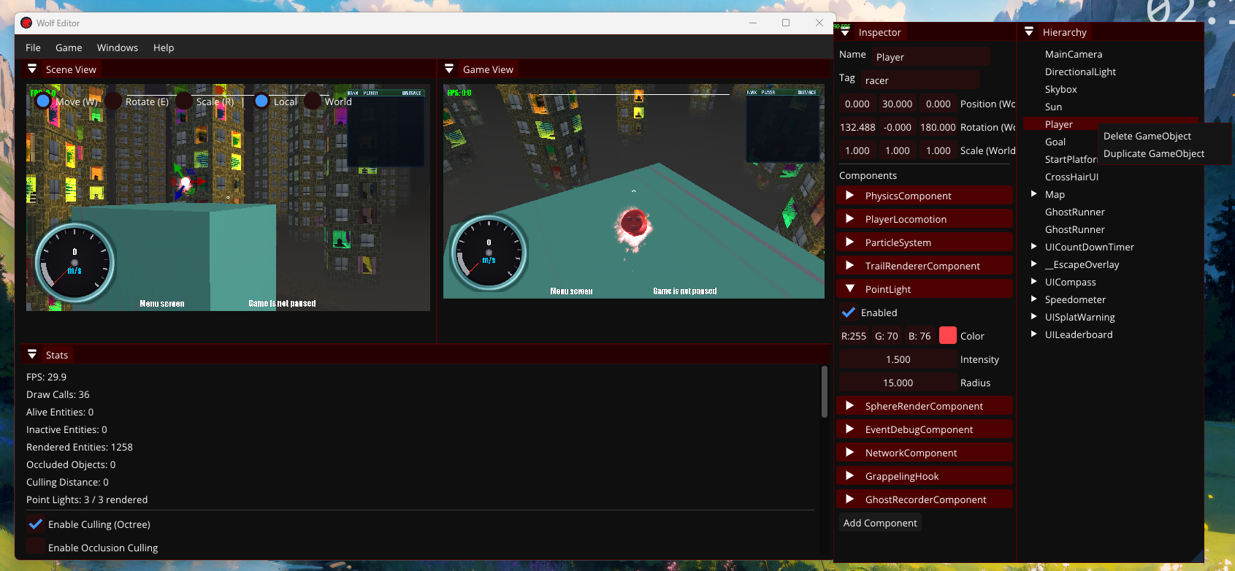
Editor

Slide 13
Engine Singleton
Provides global access point to core systems
Stores all major managers (Audio, Render, Scene, etc)
Ensures a single shared engine instance
Simplicis system access across the project
Acts as central hub for engine architecture
Notes:
The design patterns that we want to do is reduce the amount of singletons. So what we did to reduce the amount of our use of our singletons is we created a main engine singleton. So our main engine singleton basically stored all of her other managers in our system. For example, a game object manager, the UI manager, the game, the game manager, the game machine, it held all of those different values that anywhere in the system we could access. Like the game object manager, no matter where you are, you might want to look to see if there's a game object. And that's why we created the engine singleton to have a single access point to all of our different managers. Yeah.

Slide 14
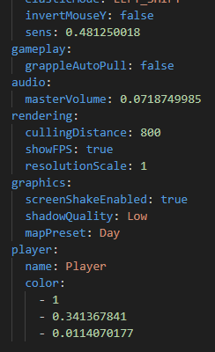
Settings Manager
Built settings manager for persistent player data
Reads/Writes settings to external files
Applies changes during runtime
Supports save/load across sessions
Example: Player customization (color, keybinds)
Written File

Slide 15
Cameras
Initial camera became too large and hard to manage
Split into Base Camera Component for shared functionality
Created specialized camera types for different modes
  Editor Camera
  Ghost Camera
  Race Camera
Each camera handles its own behavior and logic
Improved modularity and maintainability
Notes:
One of the things I created that was a part of the engine signal pin. The single engine signal pin. Single signal pin? Yeah, it was the settings manager. So the settings manager was developed because we had an issue where we wanted to save player information. For example, throughout the development, each of us wanted to have certain configurations. So I personally like to play on 1280x720, but the SAM likes to play on 1920x1080. So what we developed was a single settings manager. So the settings manager reads and writes to a file. That's basically all it does. And at start-up, we read whatever is on that file, and then we can set certain settings. For example, starting the game on 1920x1080 compared to 1280x720. So each of our systems could do separate things. And that's why we created this settings manager. I created it. Okay. Better or worse? It got longer, but I was more engaged, so I don't know if it's better or worse. Oh, okay, let me give this a shot. So another thing that I developed, or I didn't, another thing I worked on to try to fix was the cameras. So what we've done with the cameras is initially we took the SAM's camera from a previous project, and we just plopped it into the game and used that. But the problem with that is when we started to add more cameras, we filled up the camera class. There was handling several. There was handling following the player. There was handling flying, wherever you wanted to go. Ghost mode is what we call it. So what I decided to do was create a base camera component that stores the essential values, for example, the frost drum of the camera and the pitching yaw and stuff like that. And then we created two separate components. For example, the camera components that we use when we race. So that's the camera component where you're actually playing the game, and it follows the player, and it will handle only specific logic to that. And then we have the free fight camera components. So when you end a race in multiplayer, you'll be able to fly wherever you want as a spectator. And my main task, the main reason I've done this, is to separate functionality and encapsulate functionality. And encapsulate abstraction. Extract. Extract. Extract functionality. Which made it much easier to manage. That sounded decent, then. That's actually not bad. I think it's actually a pretty good target. Yeah, I think it's pretty nice. One of the other things I developed was the Game State Machine. So the Game State Machine... So... Gotcha.

Slide 16
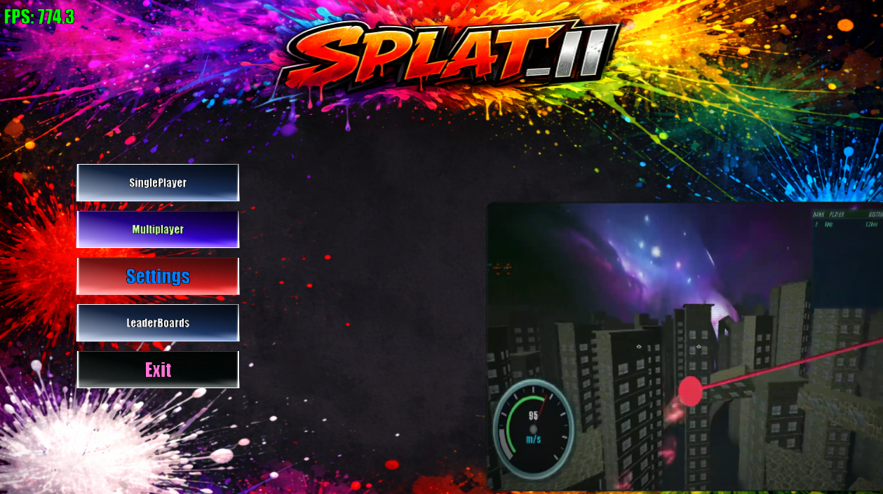
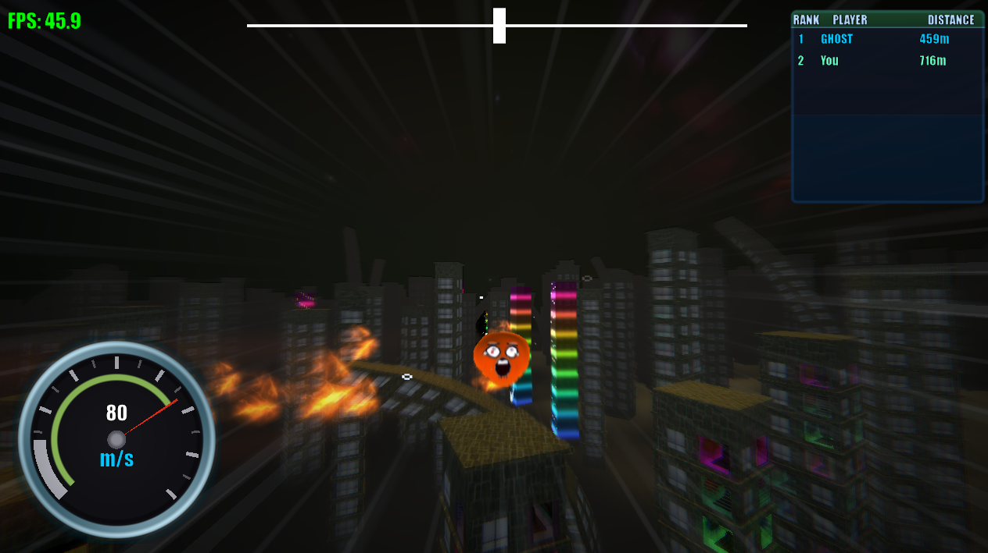
Game State Machine
MainMenuState
Scene Switching logic became increasingly complex and bloated
Introduced GameStateMancine to manage game flow
Uses Push/Pop stack-based state system
Each state controls its own logic and behaviour
Example States
  Main Menu: Handles UI input and navigation
  Race State: Manages gameplay flow and race completion
Improved separation of game logic and scene management
RaceState

Slide 17
SteamManager
Central entry point to all steam features
Stores access to steam-related managers
Handles integration with Steam API
Provides a single access point across the project

Slide 18
Steam Lobby Manager
Handles creation and joining of steam Lobbies
Uses Steam’s built in lobby system
Manages player sessions and lobby data
Supports the Networking system

Slide 19
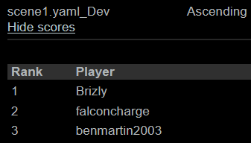
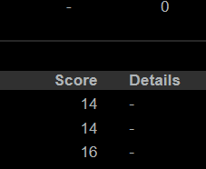
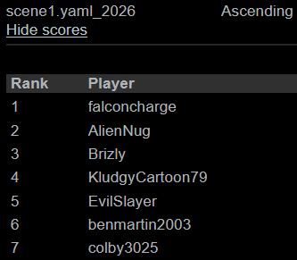
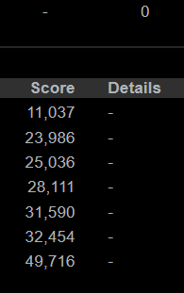
Steam Leaderboard Manager
Dev Leaderboard
Interfaces with steam leaderboard system
Steam supports ~10,000 leaderboards
Each map had its own leaderboard entry
Separate debug and release leaderboards
Automatically creates leaderboards for new maps
Release Leaderboard

Slide 20
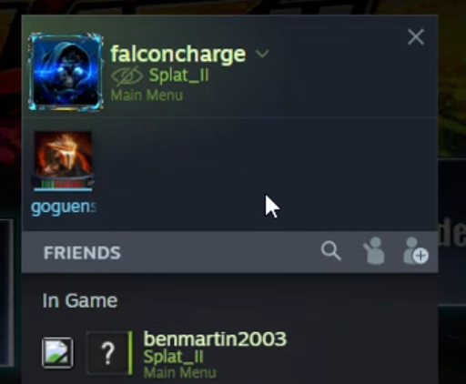
Steam Presence Manager
Handles player status / Presence updates
Syncs Steam friends list with current gameplay state
Updates activity based on current game mode
  Menu
  Lobby
  In Race
Supports joining sessions even when the game is not running (Steam invite / join support)

Slide 21

Steam Upload Process
Uses Steam’s built in upload system (steamworks)
Requires developer login through steam tools
Upload builds directly to Steam depots
Upload Workflow
  Built files locally
  Upload using Steam publishing tool
  Changes are version controlled (similar to git merge flow)
Depots
  Separate Build configuration per platform
  Example: Windows and Mac builds contain different files
  Ensures correct version is delivered for OS
Notes:
So, next one, macOS. Uploading process the same. So on Windows, the uploading process is not simple. The way I done the uploading process, basically we had to download Steam SDK, and on the Steam SDK it had a Steam executable. If you were to play that Steam executable, all I have to do is log into my Steam account and run a single command called "Make the build". And that would take all the information that would call a script that I made. And then that script would tell Steam where all the files are, and then Steam would take that information, upload the build to their website, and I could therefore go on the website and set the build to a default branch or a beta test branch. So there's two different branches that I had, beta being the fresh branch that was just out there, default was the branch that we tested and know what works, so we pushed it on to the default branch for players who play the game. Then we have bugs and trying to play test.

Slide 22
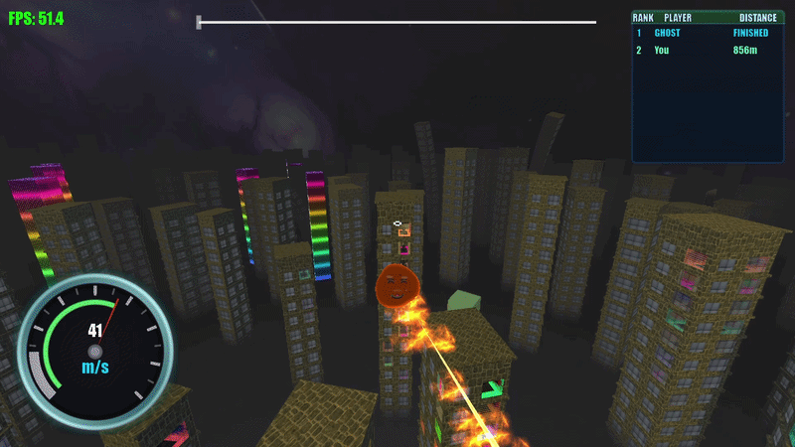
Grappling Hook
Replaced basic debug line grapple with an object
Implemented as a segmented cylinder
Segments allow for dynamic movement and flexibility
Customer shader using sum of sines
Creates a more responsive feel
Slowed video of Grappling hook

Slide 23

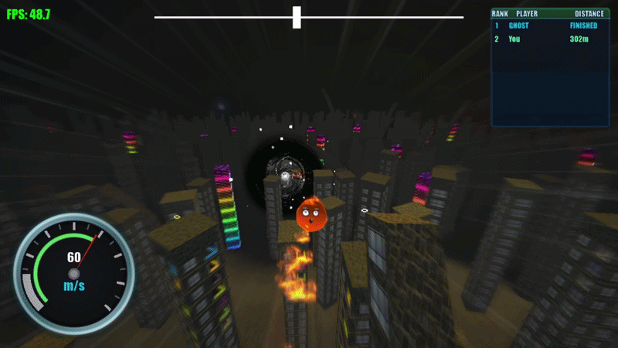
UI
UI Label
UI Slider
UIManager
  Holds all UI objects
UISlider
UI Compass
Fixed UIButton Accuracy
UILabel
UI Compass

Slide 24
Overview
World Generation
Player Systems
Visual Effects
Terrain noise, biomes, erosion, streaming, LOD, building placement, curves, instancing
Entire Locomotion, dual grapple,
Aim assist, coyote time,
crosshair, speed boosts
Volumetric fog, trail renderer, black hole shader, particle system, occlusion culling
Rendering Work
Game Systems
Engine Work
Fog integration, GPU instancing, Transparency, performance overhaul,
7 shader pairs written
Ghost replay, Cutscene manager,
Tutorial, Settings, 3 gameplay gates
Frustum culling, Octree, Bounding volumes, Occlusion, Background loader, Debug renderer
Physics
Tools
Previous Year
Jolt config, heightfield terrain, collision layers, sphere colliders, constraints
3D debug renderer, bounding volume visualizer, stats window, Tracy profiling, editor fixes
Particle system, Text rendering,
Culling system, Debug renderer.
Full performance overhaul across the entire engine

Slide 25
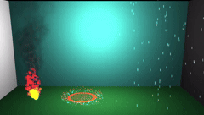
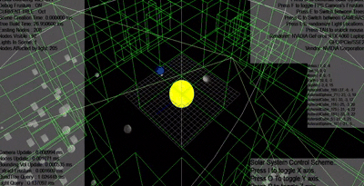
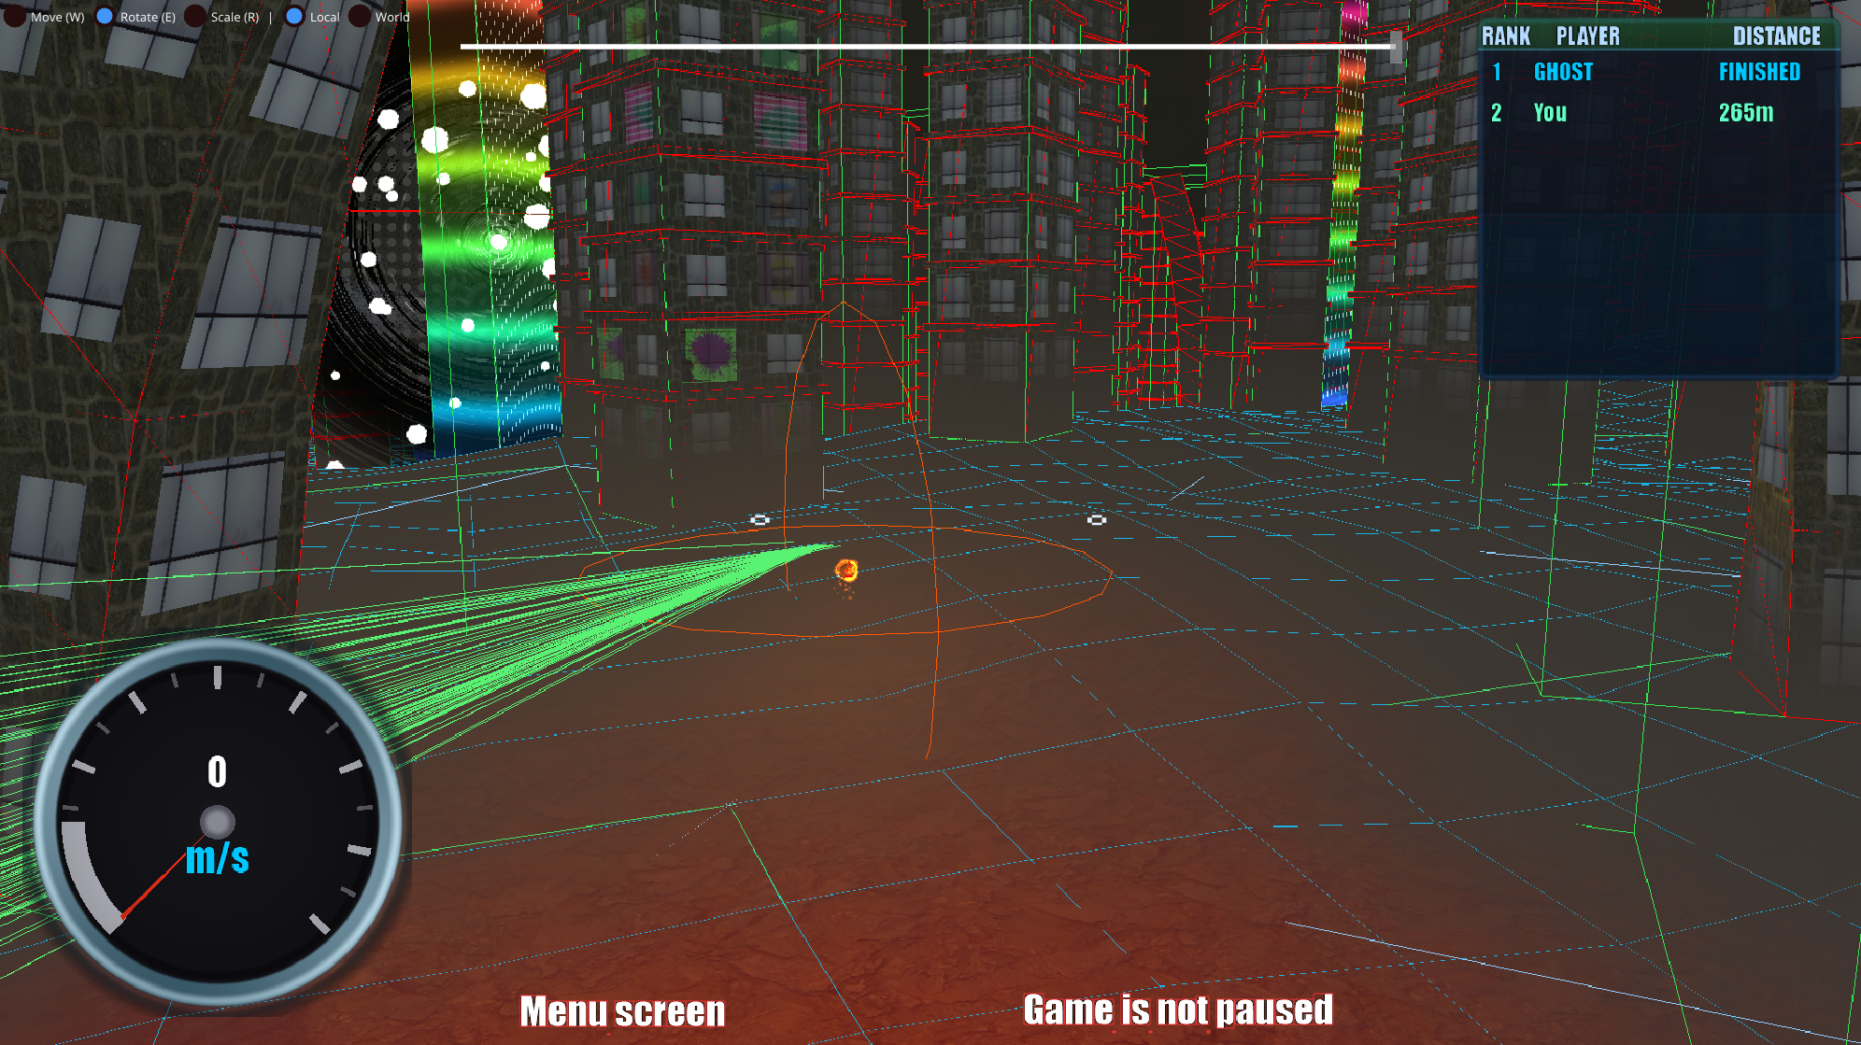
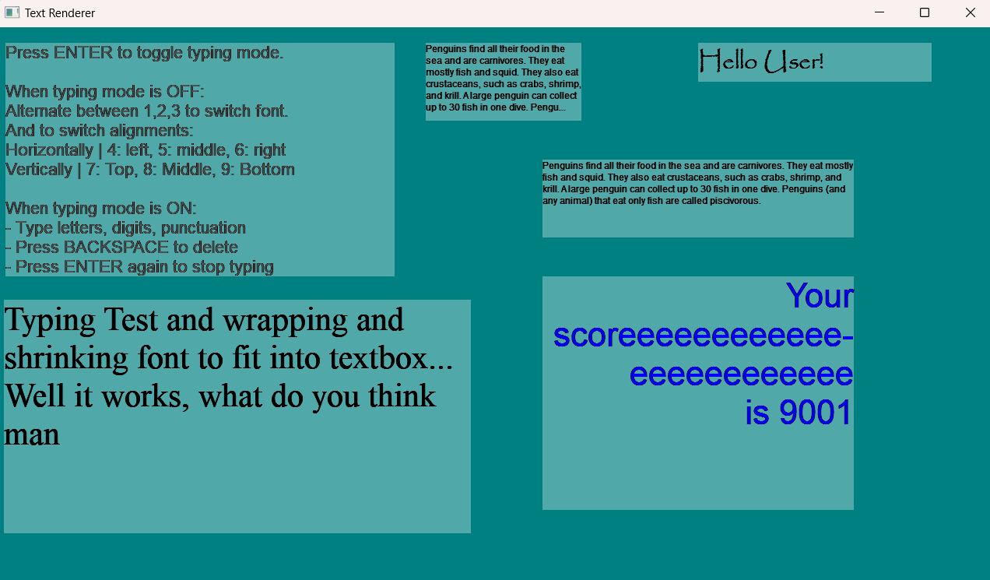
Previous Work
Clean code from last year. Good practices. Plugged in day one.
Particle System
Culling System
5 emitter shapes,
Affector pipeline,
YAML serialization, CPU depth sorting for transparency
Frustum plane,
AABB tests,
Octree spatial partitioning
Text Rendering
Debug
Renderer
Font atlas,
text boxes,
screen space scaling.
Fixed a window resize bug later
Immediate shapes,
Named layers
Most important debugging tool

Slide 26
Looks weird but is animated dw
Dual Grappling Hooks
Player Movement
PlayerLocomotion: the single biggest component in the entire project.
Aim Assist
Camera
Raycast targeting with 40 samples per frame
Coyote Time: 0.3s forgiveness for near-misses
Third person Camera with speed-reactive Effects
Constraints
Speed Boosts
Rope physics spring-dynamic constraints
Collision-triggered gates for momentum increase
Stuck in Buildings
Physics Layers
Raycast from camera -> avoid being inside buildings
Separating players, buildings, and terrain
Notes:
Game feel is not in the code, it is in the numbers. he difference between good and bad movement is tuning, not architecture

Slide 27
Looks weird but is animated dw
Dual Grappling Hooks
Dual Grappling Hooks
PlayerLocomotion: the single biggest component in the entire project.
Aim Assist
Aim Assist
Camera
Raycast targeting with 40 samples per frame
Coyote Time: 0.3s forgiveness for near-misses
Raycast targeting with 40 samples per frame
Coyote Time: 0.3s forgiveness for near-misses
Third person Camera with speed-reactive Effects
Constraints
Constraints
Speed Boosts
Rope physics spring-dynamic constraints
Rope physics spring-dynamic constraints
Collision-triggered gates for momentum increase
Stuck in Buildings
Stuck in Buildings
Physics Layers
Raycast from camera -> avoid being inside buildings
Raycast from camera -> avoid being inside buildings
Separating players, buildings, and terrain
Notes:
Game feel is not in the code, it is in the numbers. he difference between good and bad movement is tuning, not architecture

Slide 28
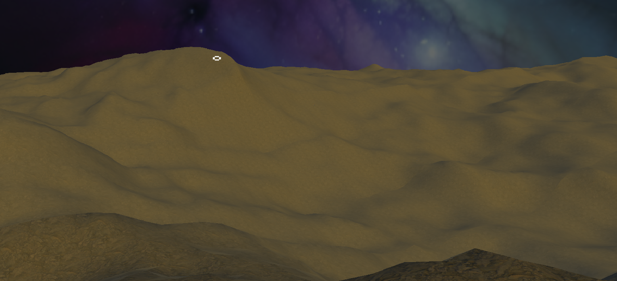
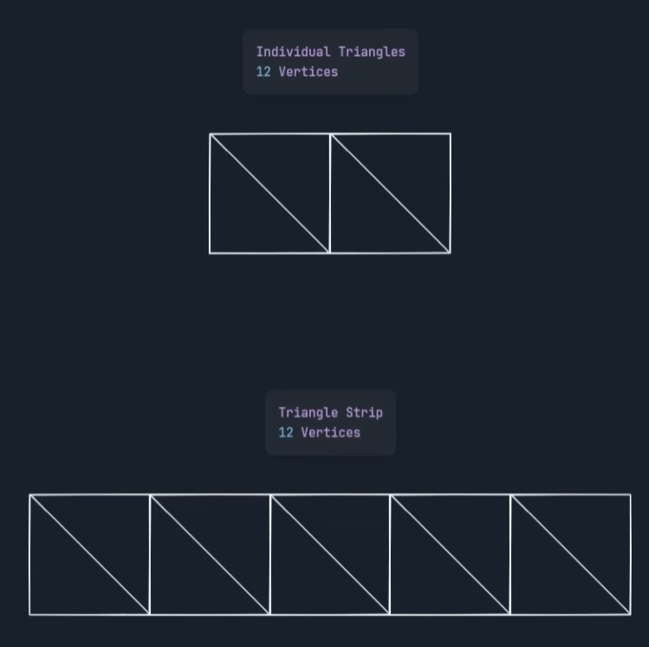
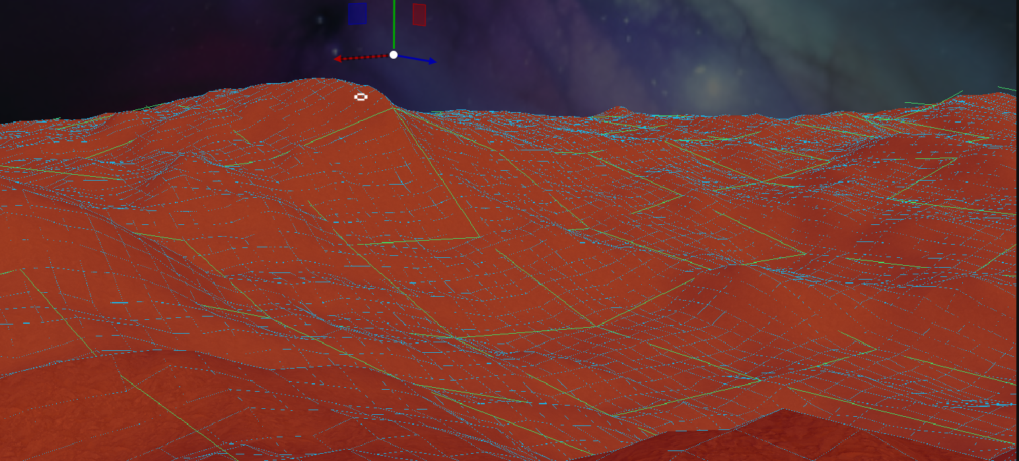
A float typically uses 4 bytes.
Terrain System
Full pipeline: generation, streaming, rendering, physics. All procedural.
Noise
Layered Perlin noise with basic biome blending & thermal erosion
Streaming
Chunks stream on worker threads with LRU atlas cache
Challenge
Chunks unloading while still referenced caused crashes
Vercidium - Youtube

Slide 29
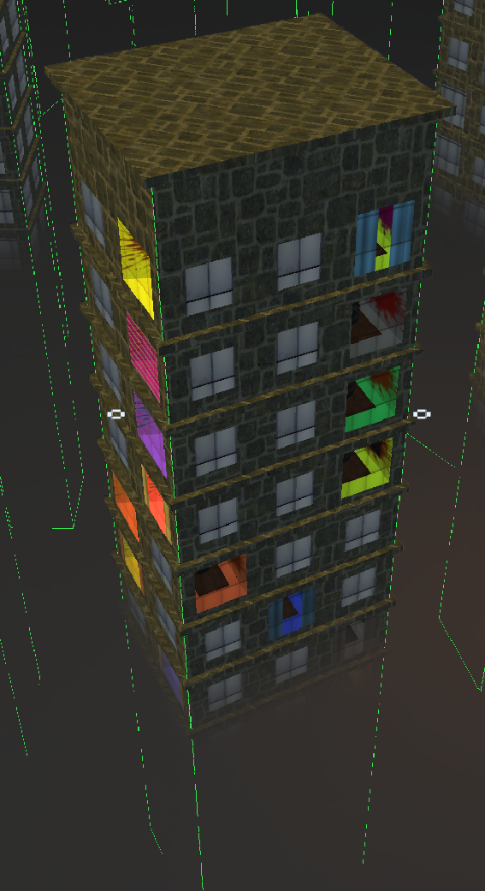
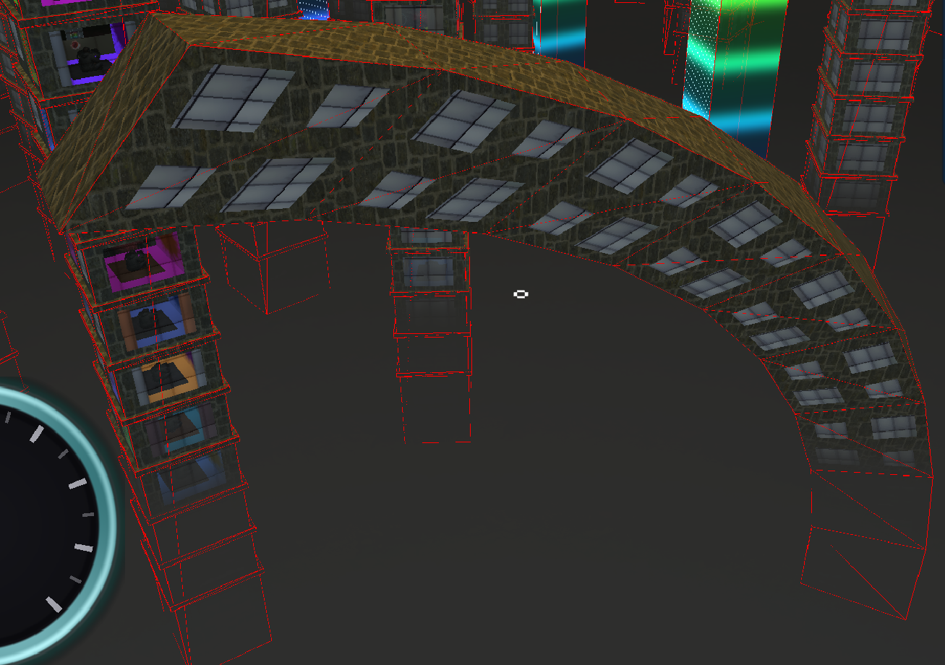
Buildings: How They Are Made
Flat Top
Curved / Arched
Two types
GPU-Instanced: hundreds in 1 call
Curved Buildings
Visually bend on GPU
Physics collider bends on CPU
Matching CPU to GPU
Multiple rewrites

Slide 30
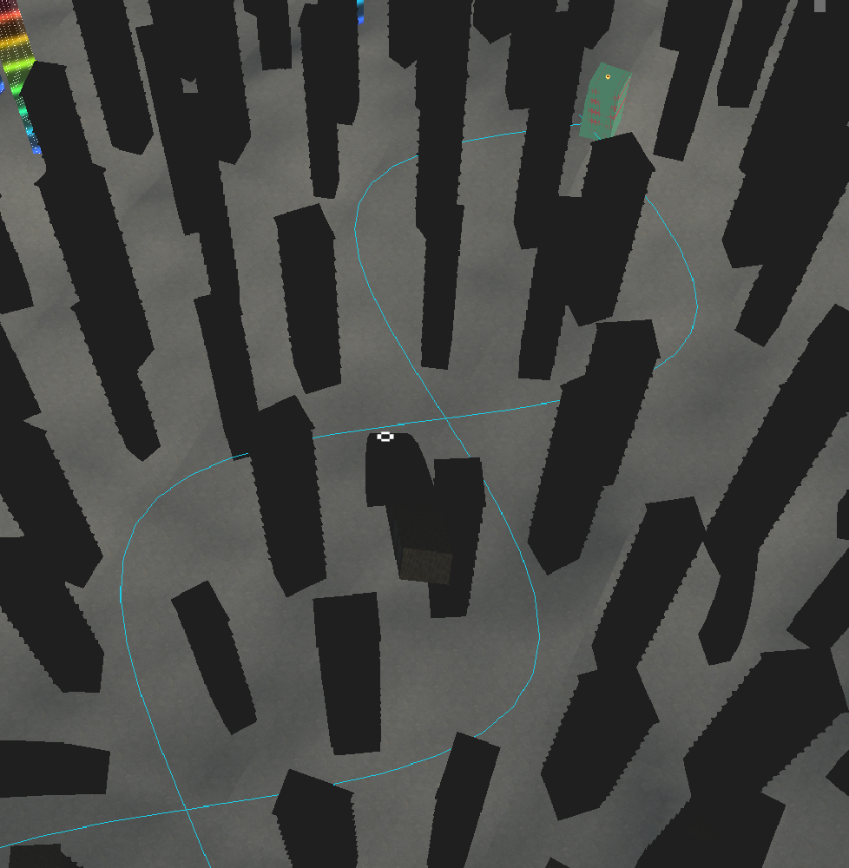
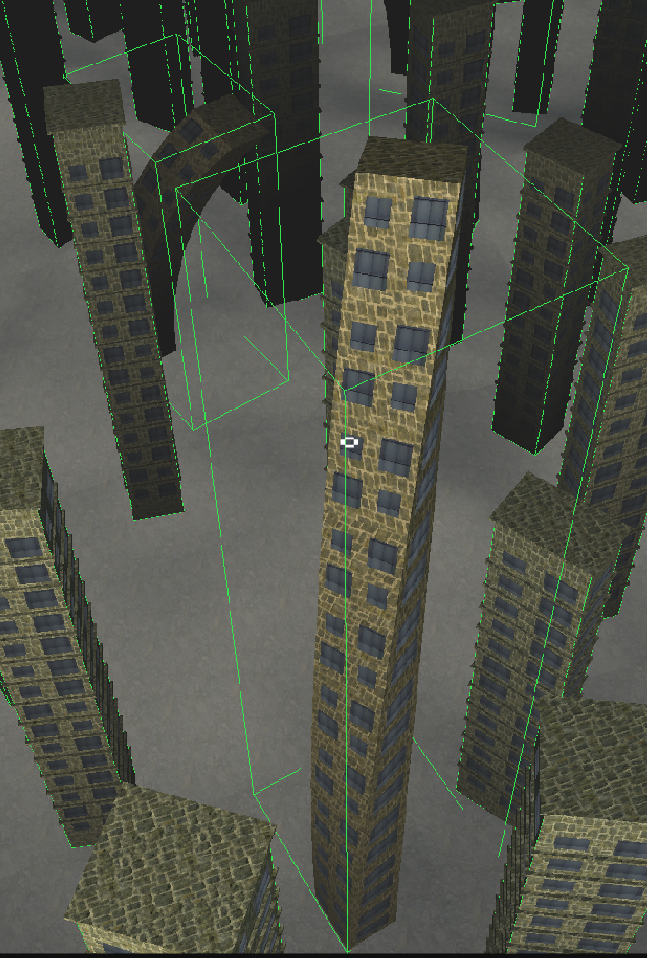
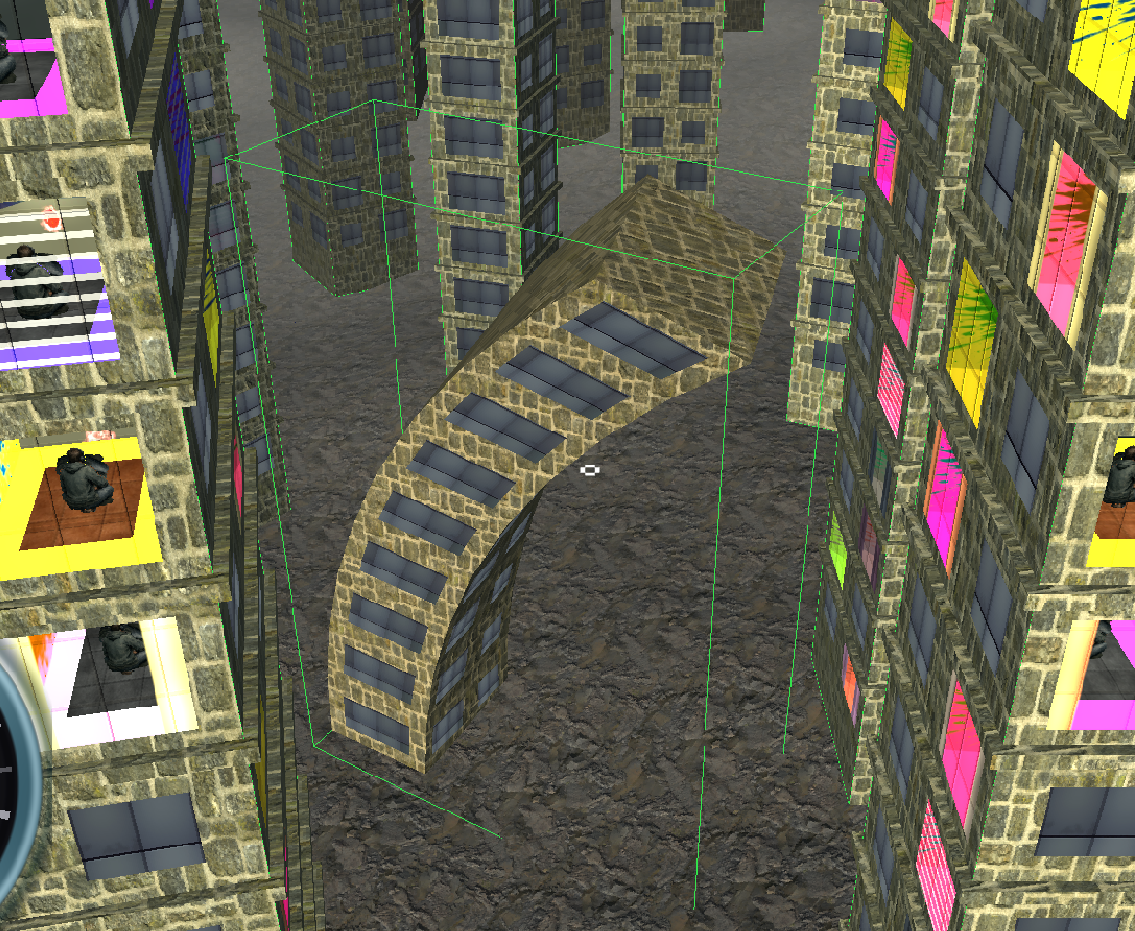
Buildings: How They Are Placed
Every building generated at runtime. Not one placed by hand.
Rule-Based Procedural City
Noise masking and jitter for downtown-like density
Height scaling for visual progression
Route System
Ensuring doable map every generation, used for cutscene
Trial & Error
Every placement rule was added because of a bug

Slide 31
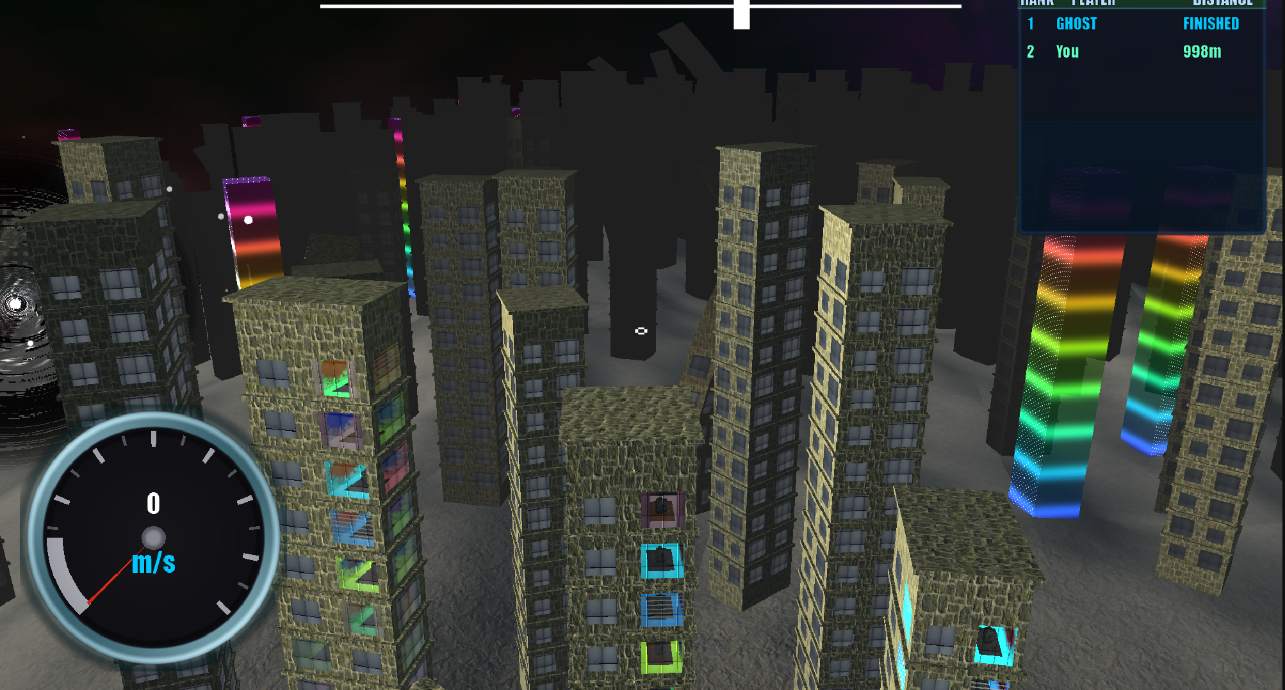
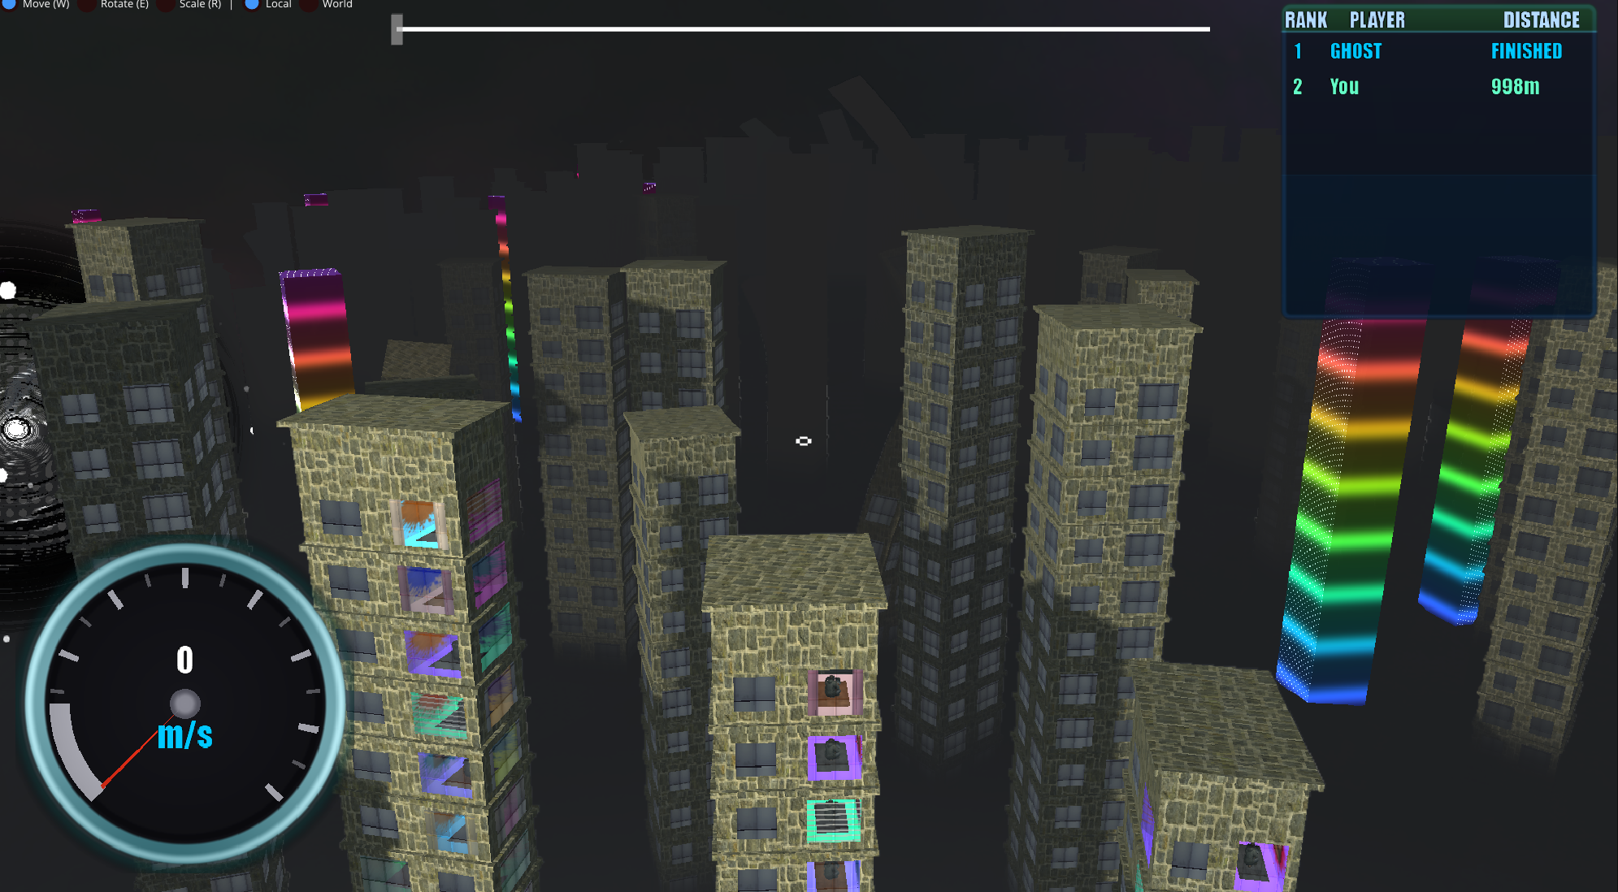
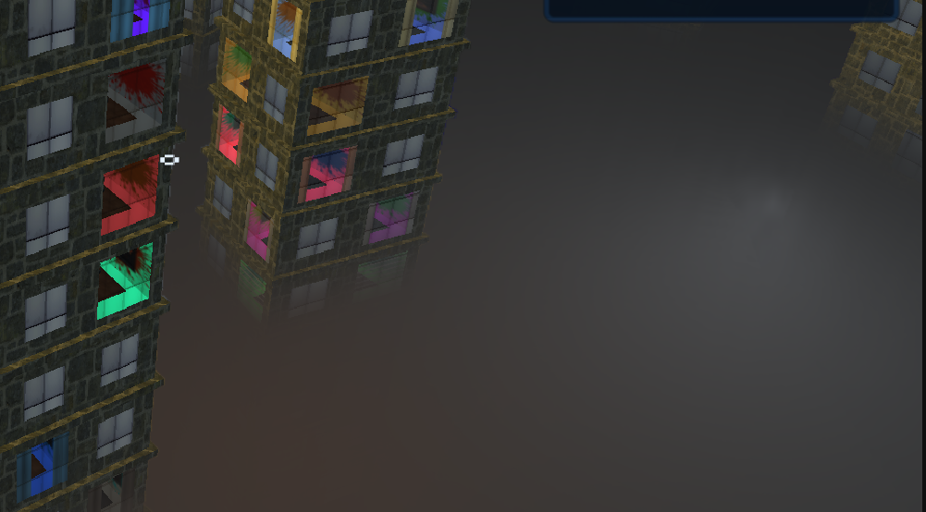
Volumetric Fog
Four major iterations.
Technique
Screen-space ray marching with scattering
Half Resolution, Smoothing and height offset
Renditions
Basic -> Layered -> Thin Film -> Ray Marched
Learnt
Half-res = good, Iterating on these renditions was necessary to reach the final result

Slide 32
Trail Renderer
Researched, built from scratch, optimized.
Technique
Ring Buffer with custom shader between player world-space points
Problem
Covered screen, felt flashy, Iterated
Game Changing
Added late, gave the game a fresh feel

Slide 33

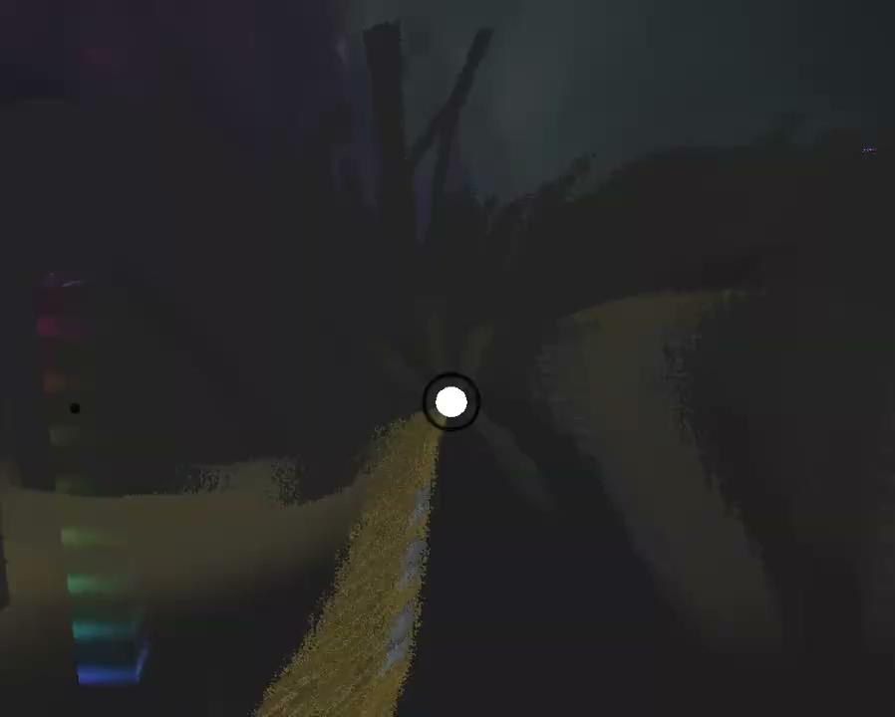
Black Hole Shader
Replaced the basic goal with a fully procedural effect. No textures, all math.
Technique
Spiral arms, Halftone, Distortion
Visual Gameplay Cue
Interacting with environment, Particles pulled in
Difficulty
Shader toy for hours

Slide 34
Ghost Replay
Race against yourself. Binary recording and playback.
How
Binary Ghost recording at 30 fps | 56 bytes/frame
Issues
Ghost drifted out of sync; race clocks & cutscene addition
Performance
Binary is way faster than YAML or JSON, saved straight to disk

Slide 35

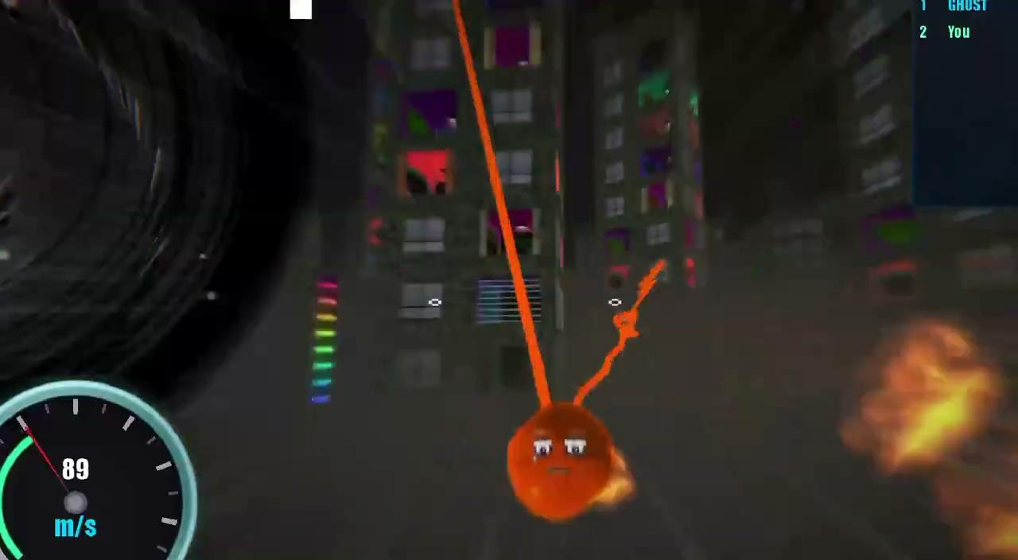
Cutscene System
For cinematic sequences.
Queue-Based Camera
7 command types for the camera to follow
Issue
Camera was inconsistent following a path
Fixed using splines and curves
Arc-length parameterization
Constant speed regardless of how sharp the path curves

Slide 36
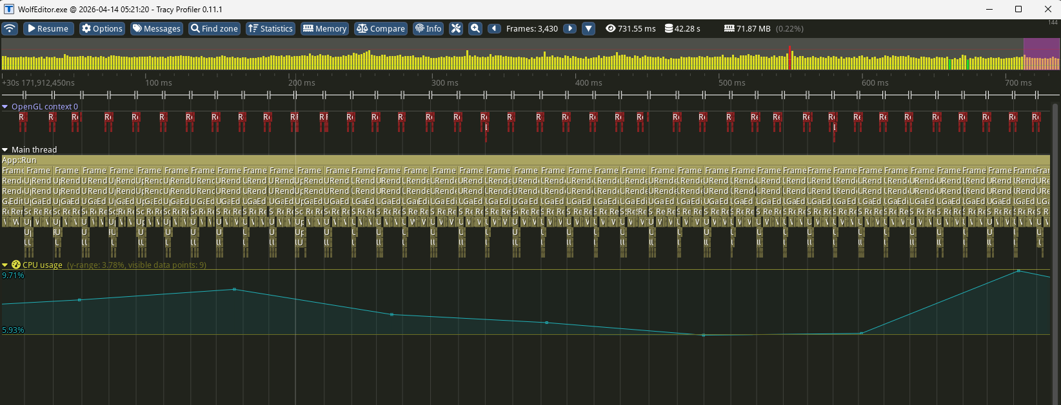
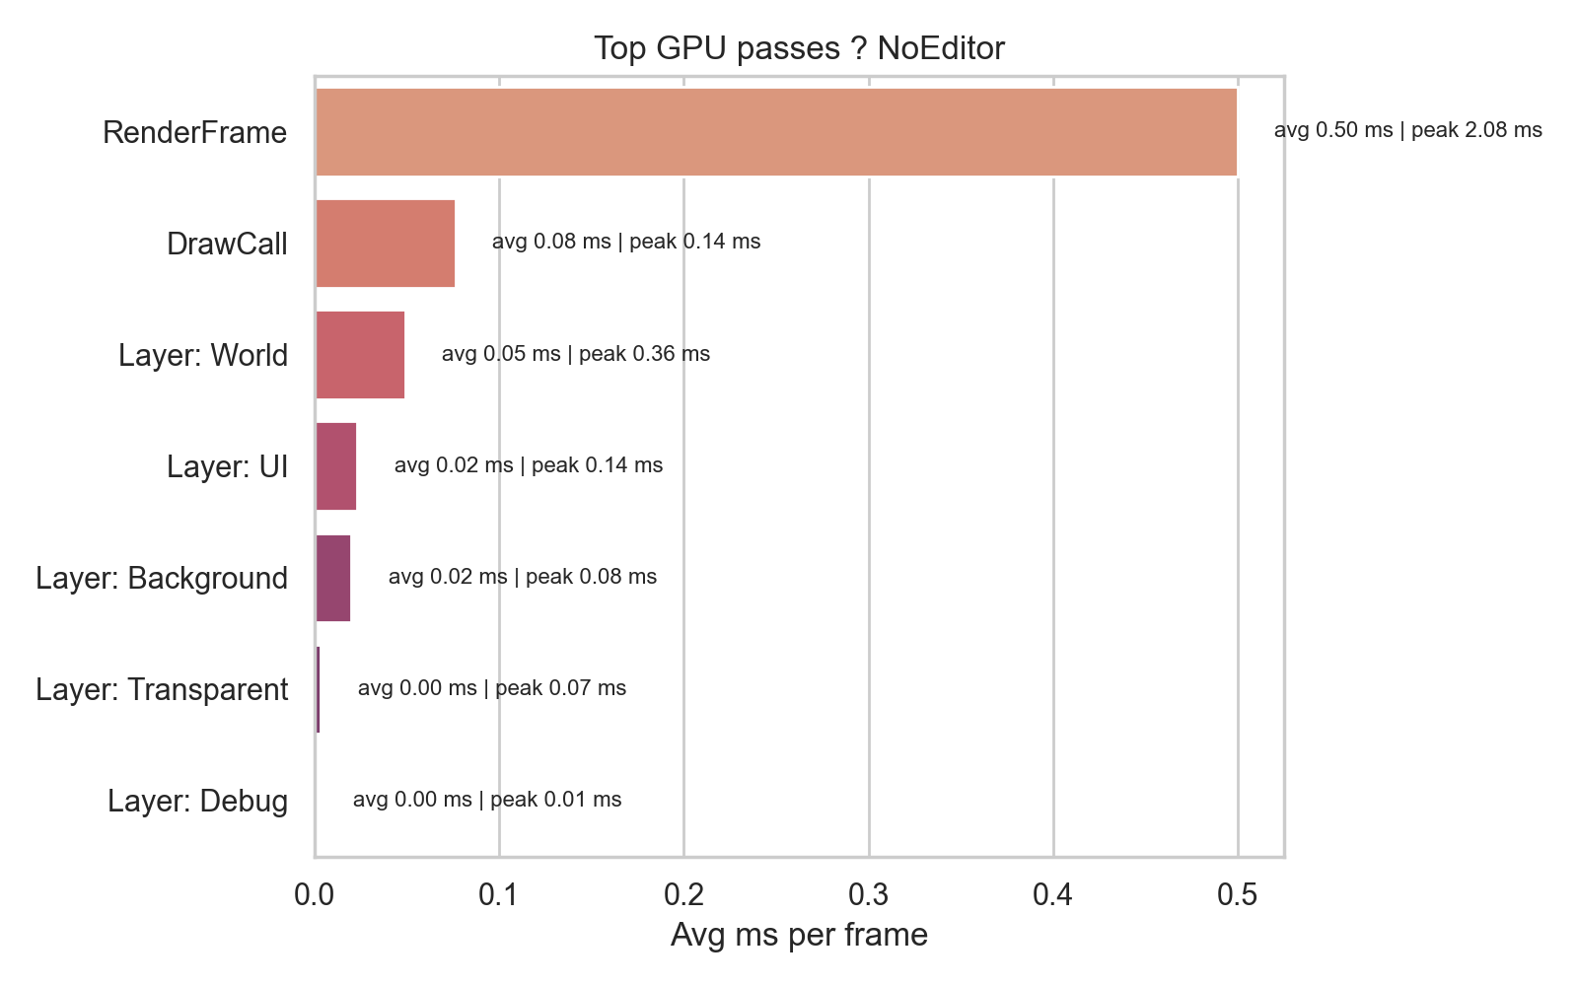
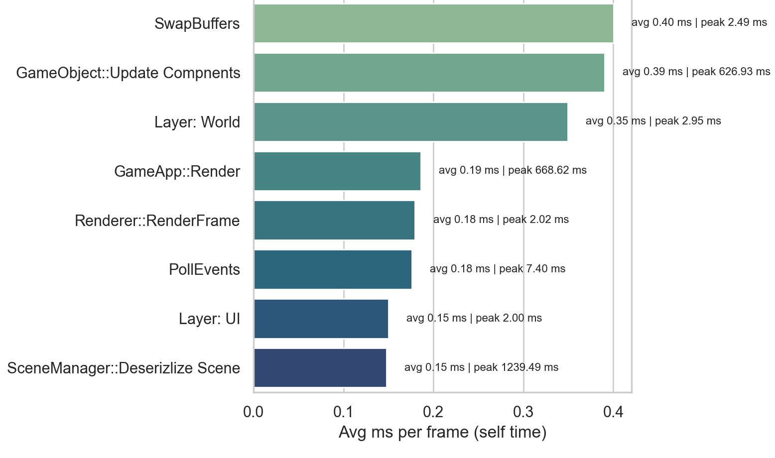
Optimization Flow
Profiled with Tracy.
Profiling Pipeline
Optimization
Saved tracy exported to CSV
Categorizes every zone by subsystem (renderer, physics, etc)
Generates charts
Fixed building additions not instancing
YAML save file sizes decreased
Refined culling logic for long distance maps
Chunked buildings and culled larger amounts (smaller = more CPU usage)
Background Loader
Eliminated frame spikes but player spawns before other systems intialized, constant crashes - removed

Slide 37
Thanks

